Slide 1

Scrum and Forecasting
Joel Dickson and Supaket wongkampoo
Development Manager at Agoda
NUnit Core Team Member

Slide 2
Story Point Estimation
Do you trust developers to give you accurate estimates?
I Don’t… So I stopped asking them for time estimates, I ask them for T-Shirt sizes instead
On Story points - Pedro Gustavo Torres of Sonae
Accuracy and precision are not the same thing. Precision is a lot more expensive. Precision is always desired, but accuracy creates more value. However, story points provide sufficient accuracy when working in nondeterministic systems.
Time has no direct relationship to progress, but the rate of effort resolution will forecast completion.
Velocity stabilizes story point estimates, so you get more predictability, which is the ultimate goal of creating estimates.
https://www.scrumalliance.org/community/articles/2016/february/story-points-explained-the-what-why-and-how

Slide 3
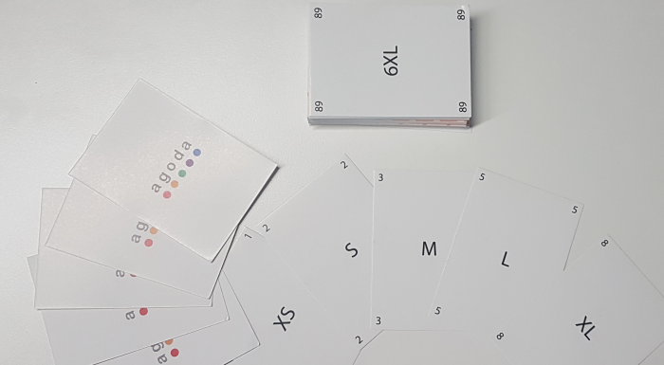
Planning Poker
Its Fun
People laugh
It makes Estimation less serious, and developers hate estimations because it causes them stress
Use of a Fibonacci sequence
Correlates T-Shirt Size to Points

Slide 4
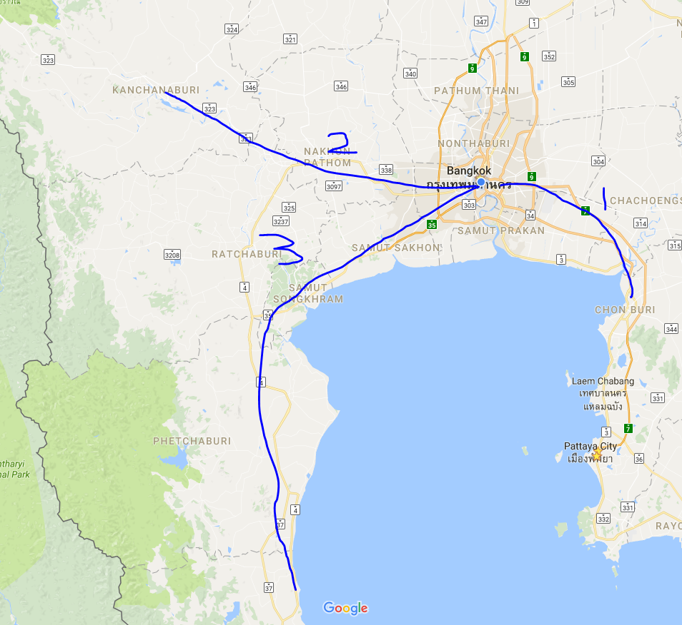
Relative Values
Maybe I can't tell how long it will take me to make a trip from Bangkok to Chon Buri, Kanchanburi, or Hua Hin. But if I say that the distance between Bangkok and Chon Buri is 1, then the following statements are true:
Bangkok to Chon Buri is 1.
Bangkok to Kanachanburi is 2.
Bangkok to Hua Hin is 3.
We don’t know exactly how long it will take but we know relatively if we have driven one of these before.

Slide 5
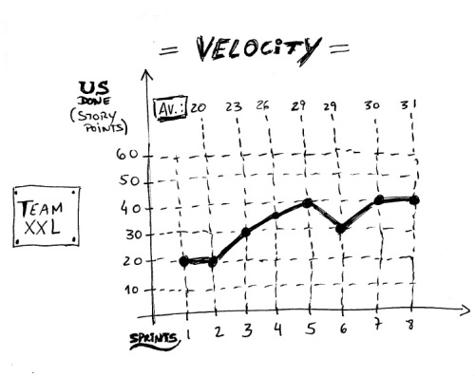
Velocity Calculation
Based on the last 4 sprints you should have an average velocity calculation
Use this to add roughly this amount of stories to the next sprint in planning
Manually adjust number using rough estimation for thing such as public holidays etc.

Slide 6
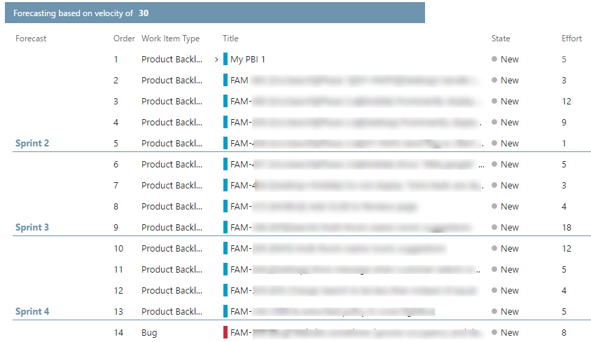
Forecasting with Velocity
Adding forecasting lines to the backlog
If we know that our velocity is 30, then we know that the next 30 points worth of work will be done next sprint, the following 30 the sprint after and so on

Slide 7



Questions?
Scrum
Joel Dickson
Development Manager at Agoda
https://beerandserversdontmix.com/
www.linkedin.com/in/joel-dickson-hs
https://github.com/dicko2/ _

